Slide 1
Emotion Tech Inc.
&
Employee Engagement
Emotion Tech Inc.
Marketing Department
Hayato Sudo

Slide 2













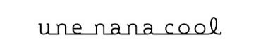
About Us
Company
Emotion Tech Inc.
(Founded in 2013)
Address
Hirakawa-cho 2-5-3
Chiyoda-ku, Tokyo
Business
Customer Experience management system “EmotionTech”
Employee Experience management system “EmployeeTech”
Fund
600,226(million, yen)
400+ Our Clients

Slide 3
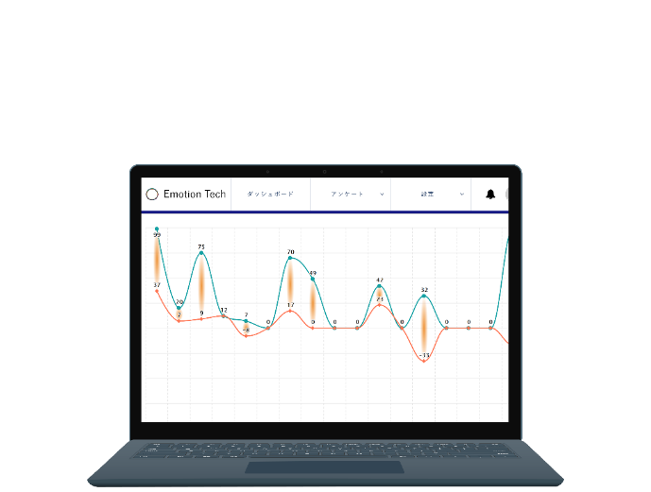
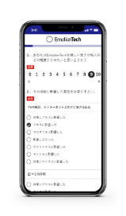
Our Business
Engaged Employee can make Great CX,
Great CX can Growth Company
Company
Growth
Employee
Engagement
Customer
Loyalty
EmployeeTech
EmotionTech

Slide 4


About Us (EmployeeTech : EX Management System)
■the 3rd HR Technology Award
経済産業省後援、ProFuture株式会社
「第三回HRテクノロジー大賞」
労務・福利厚生部門
優秀賞
■HR Award 2018
全国120,000人の人事キーパーソンが選ぶ「HRアワード2018」
組織変革・開発部門
最優秀賞 受賞
Notes:
こういった取り組みをご評価いただき、昨年この様な賞も受賞させていただきました。

Slide 5
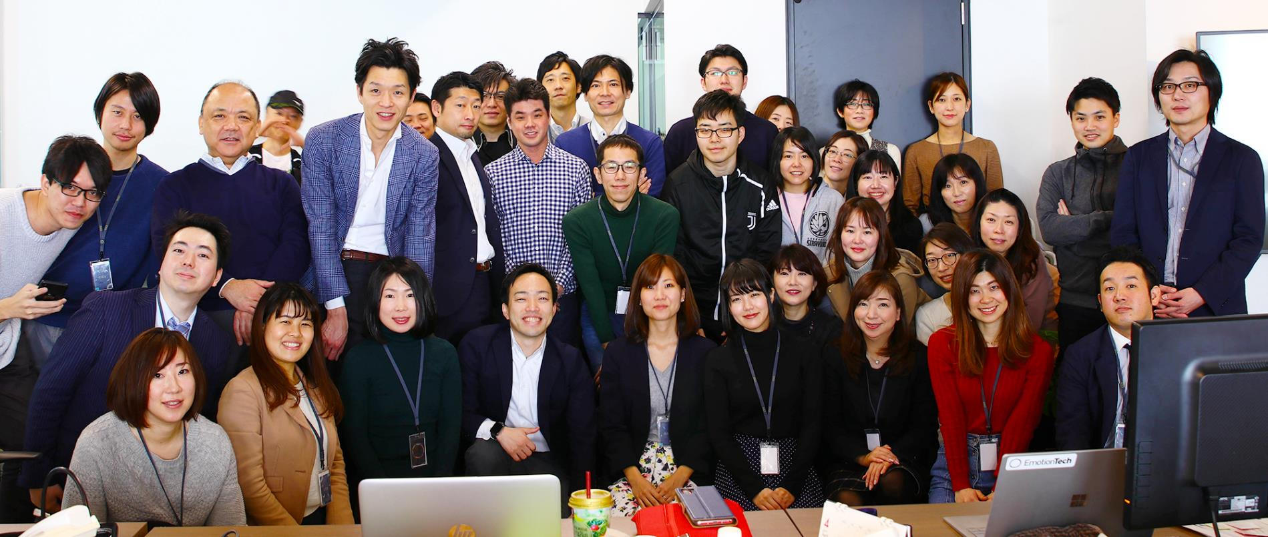

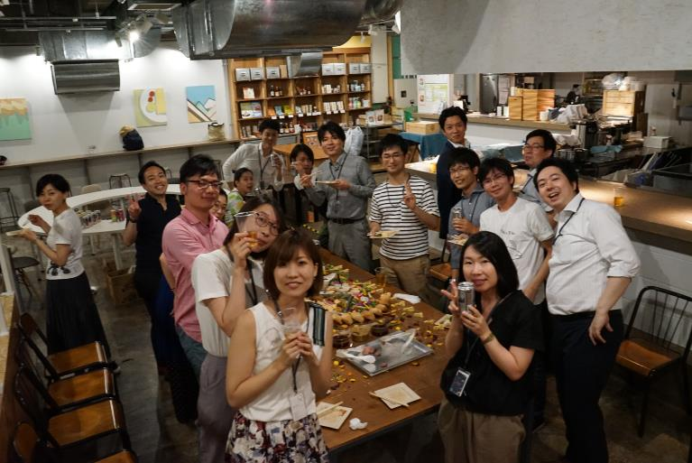
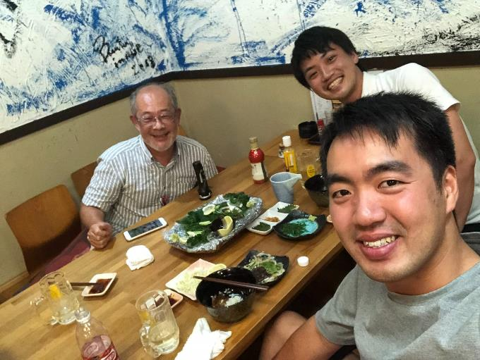
About Us
50+ members
me
Sensei
Andrew
Notes:
Even this kind of big company now focus on improving cx

Slide 6
The Way of Improving
Employee Engagement
3steps

Slide 7
Measure, Analyze, Take action
Measure
Analyze
eNPS
Employee
Journey Map
Take action
Keep
Turning circle

Slide 8
Measurement of
Engagement

Slide 9
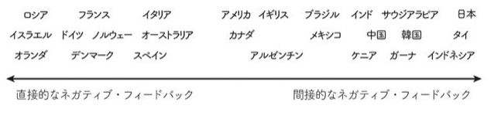
The term “Satisfaction” can’t measure emotion effectively
Satisfaction Question : “Are you satisfied with your organization as a workplace?”
■Japanese are not good at showing “direct negative feedback”.
80% of leavers answered “satisfied” or “very satisfied” in the last satisfaction survey.
■Satisfaction cannot measure commitment
If you do easy work with high salary, your satisfaction level will be high. But it doesn’t mean “you are engaged”.

Slide 10
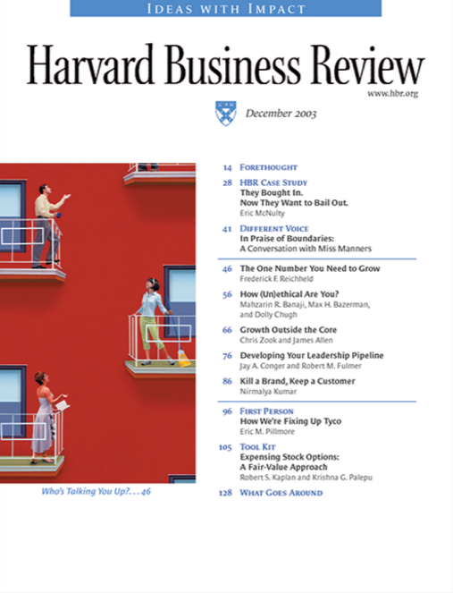

From 2003
In 2003, a partner of Bain and Company released “NPS”
He verified NPS has strong connection with company growth.
In 2003
to solve “satisfaction problem”
Net Promoter Score
Employee Net Promoter Score

Slide 11
CXMの支援
What is Net Promoter Score?
To measure eNPS, we ask recommendation score.
How likely is it that you would recommend your employer
to a friend or acquaintance?
0
1
2
3
4
5
6
7
8
9
10
Notes:
11points scale
After customers select their own scale

Slide 12



CXMの支援
What is Net Promoter Score?
We divide customer in 3 segments. Promoter, Passive, Detractor.
How likely is it that you would recommend your employer
to a friend or acquaintance?
0
1
2
3
4
5
6
7
8
9
10
Detractor
Passive
Promoter
Notes:
Then we devide customer in 3 segument
Passive kind of neutral

Slide 13
CXMの支援
What is Net Promoter Score?
Calculate each ratio.
Take detractor ratio from promoter ratio.
How likely is it that you would recommend your employer
to a friend or acquaintance?
0
1
2
3
4
5
6
7
8
9
10
Detractor
Passive
Promoter
20%
35%
45%
eNPS
＝
－
25
Promoter45%
Detractor20%
＝
Notes:
45% minus 20 which is equal to 25
This is our metrix. Or indicator

Slide 14
Analyze
Employee Experience

Slide 15
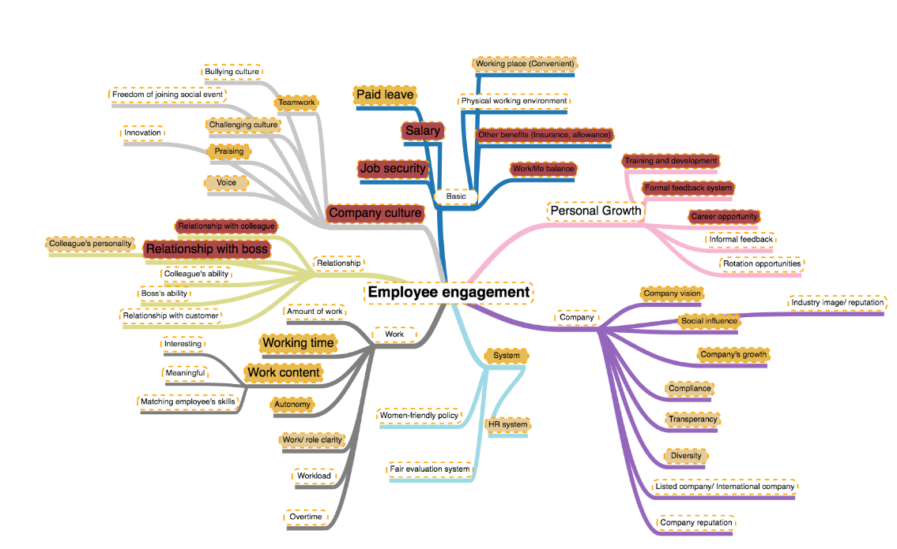
To make Questionnaire
We analyzed comments about eNPS.
Work
Growth
People Relationship
Company
Company Culture
Basic

Slide 16
To make Questionnaire
We divided 27 factors for 6 categories
マトリックス | Work | 1 | I satisfies with my working content.
 |  | 2 | My working time is appropriate.
 |  | 3 | I have appropriate amount of work.
 |  | 4 | I have enough job autonomy to finish my responsibilities easily.
 | Growth | 5 | I have always received feedback from my colleagues/manager about my work.
 |  | 6 | My company offers appropriate training and development programs that can help me grow.
 |  | 7 | Considerating all my efforts and achievement, I am promoted appropriately.
 |  | 8 | I have been rated fairly.
 | People relationship | 9 | I have good colleagues.
 |  | 10 | I have a good manager.
 |  | 11 | Customers often show their satisfaction with my services.
 | Company | 12 | The work I am doing is achieving my company vision.
 |  | 13 | My company grows sustainably.
 |  | 14 | My company has positive influence to my society.
 |  | 15 | My company is fair regardless of age or gender, nationality
 | Company culture | 16 | My opinions or ideas have always been listened.
 |  | 17 | I am recognized when I do a good job.
 |  | 18 | My team/department always take actions to rapidly adapt to market and environmental changes.
 |  | 19 | My team/department always persuits new ideas or inventions in company's products, services or working procedure.
 |  | 20 | Management keeps me informed about important issues.
 | Basic | 21 | Considerating all my efforts and achievement, I receive reasonable direct benefits.
 |  | 22 | I can take enough paid leave without pressure.
 |  | 23 | My company offers me appropriate other benefits.
 |  | 24 | I do not have to worry about my job security at my company.
 |  | 25 | My work commute time is short.
 |  | 26 | It is easy to balance my work and life.
 |  | 27 | My company provides me a good physical working condition.

Slide 17
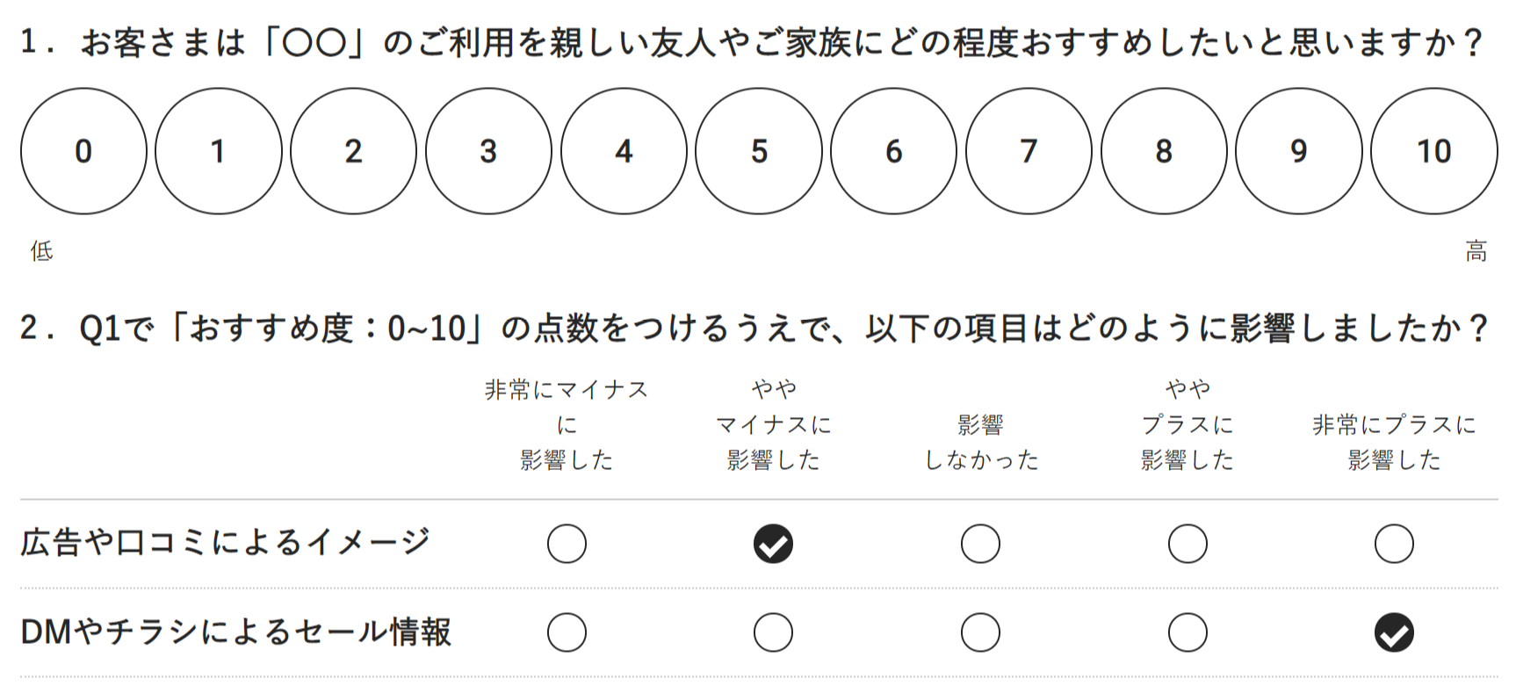
To make Questionnaire
eNPS question and questions about factors.
To make it simple.
How likely is it that you would recommend your employer to a friend or acquaintance?
Q2
For each of the following statements, please choose the description closest to your own thoughts.
Disagree
Slightly
Disagree
Neither
agree not disagree
Slightly
Agree
Agree
非常に
マイナスに影響した
やや
マイナスに影響した
影響
しなかった
やや
プラスに影響した
非常に
プラスに影響した
I satisfies with my working content.
Q3
My working time is appropriate.
︙
︙
︙
︙
︙
︙
To measure each factors based on 6 categories.

Slide 18
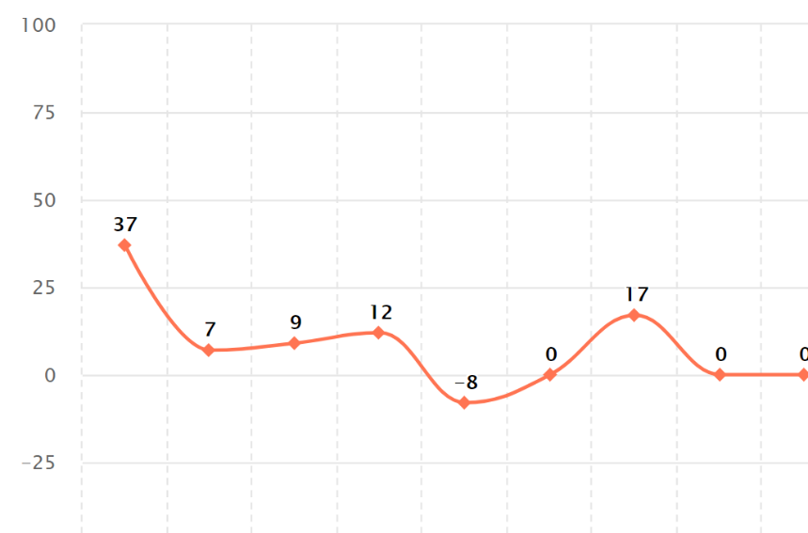
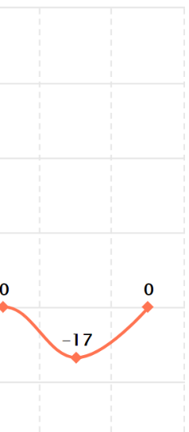
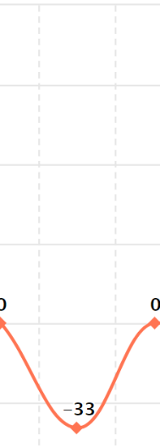
Analyze data
Calculate current status. Which factors are employee satisfied with?
We usually use regression.
Work
Content
Work
time
responsibility
Autonomy
Diversity
Transparency
Innovation
Company vision
Company growth
Salary
Paid time off
Relationship with boss
Relationship with colleague

Slide 19












How should we analyze data?
If we solve the problem about dissatisfied point, we can’t make engaged employee.
We should find factors that we can create loyal customers.
Q
How likely would you
Recommend?
eNPS is
Low
eNPS is
High
2
0
9
10
1
10
Which factors have impact to
these 2 groups?

Slide 20
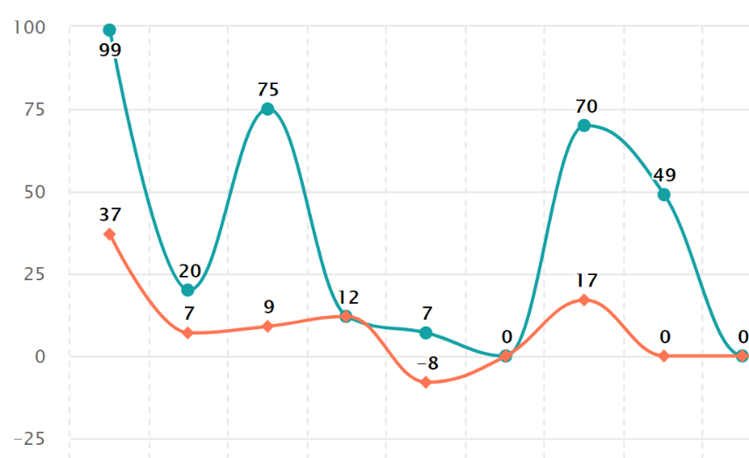
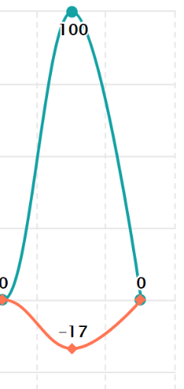
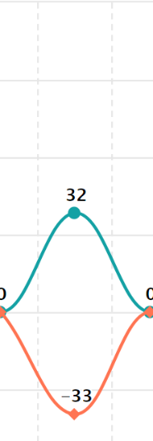
Analyze data
Calculate each factors impact to eNPS.
Work
Content
Work
time
responsibility
Autonomy
Diversity
Transparency
Innovation
Company vision
Company growth
Salary
Paid time off
Relationship with boss
Relationship with colleague

Slide 21
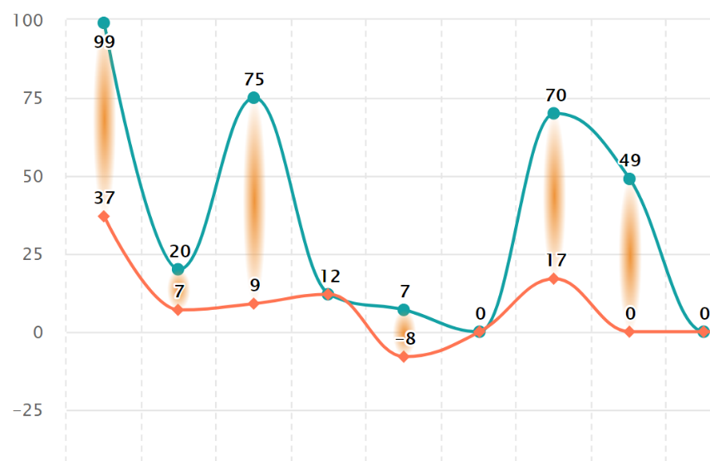
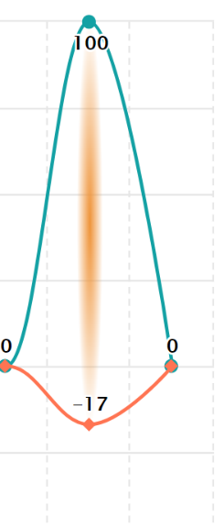
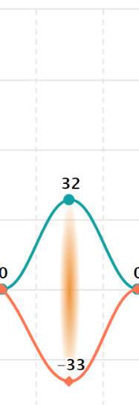
Analyse date
The factor which has strong impact and low score is important.
We watch the “Gap” between impact and score.
Work
Content
Work
time
responsibility
Autonomy
Diversity
Transparency
Innovation
Company vision
Company growth
Salary
Paid time off
Relationship with boss
Relationship with colleague

Slide 22
Take action

Slide 23
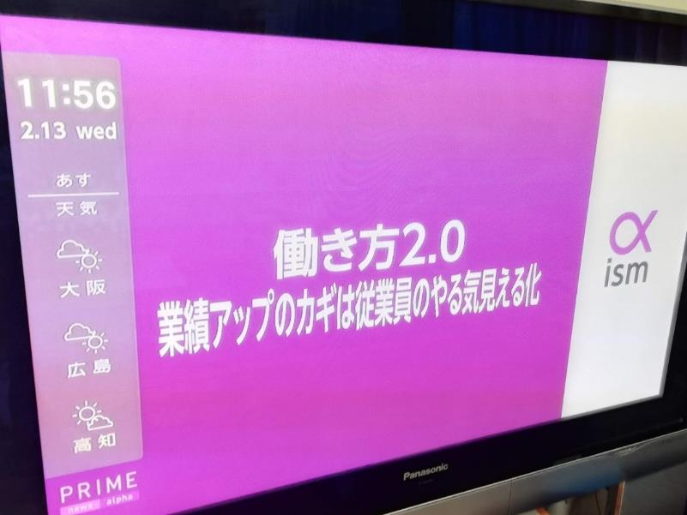
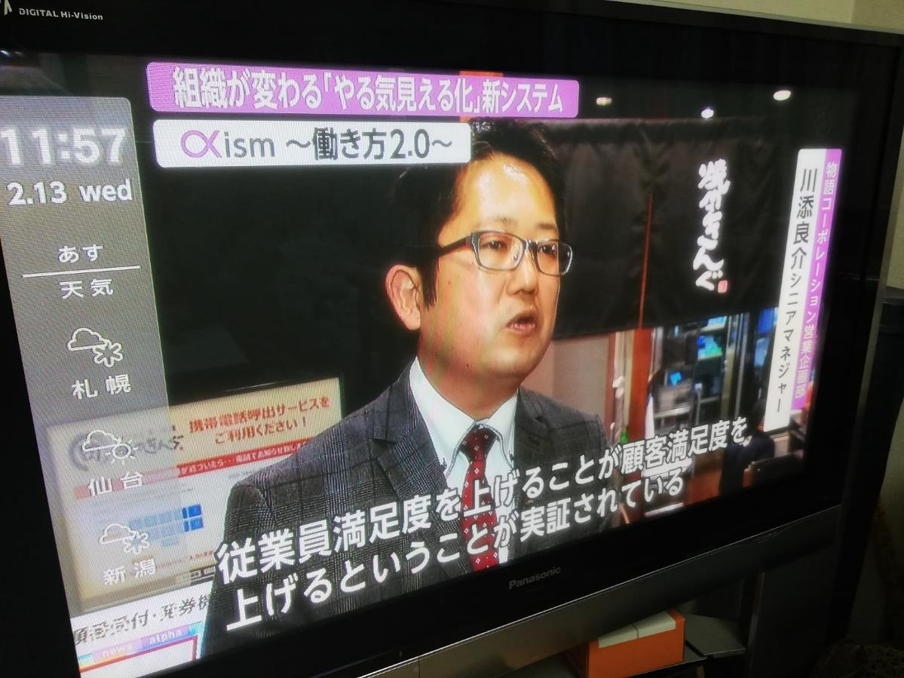
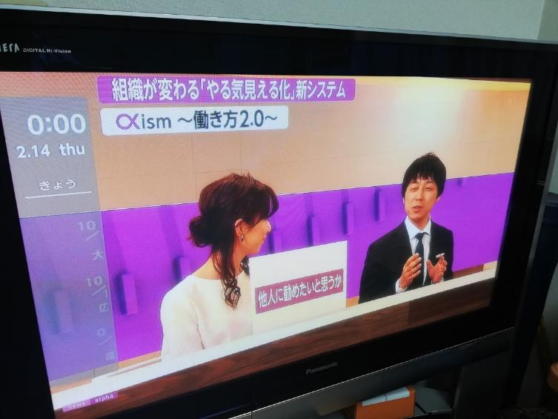
Case : Restaurant Business
Fuji Television

Slide 24

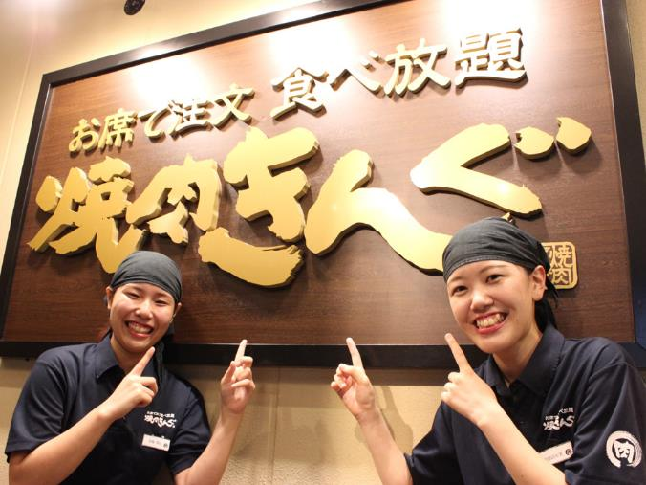
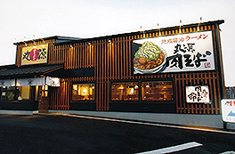
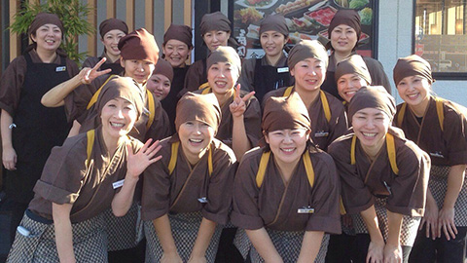
Case : Restaurant Business
【Company】
500+ restaurants in the world (mostly in Japan).
【Organization Problem】
1.Retention Rate about Part time associates .
2.Traning their leader (shop manager).

Slide 25






Keep Turning circle
1
Collect answers every 3 months.
2
Shop manager got analyzed data.
9
調査
分析
EX
改善
4
Taking Action.
策定
改善
3
Shop manager make
Action Plan.

Slide 26

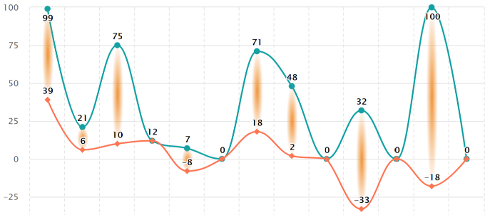
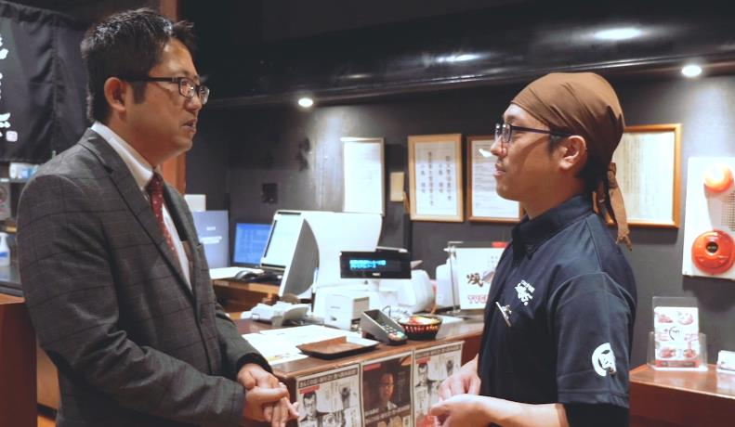
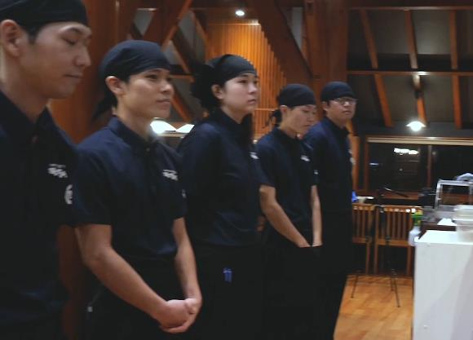
Training Shop Manager with eNPS data.
He got analyzed data.
Some employee said they can’t feel their growth.
Making action plan.
He set goal for each new employees.
Ex) 1st month, 2nd month, 3rd month.
He shared informtion for other members.
He shared organization problem with every members.
Then, each employee take actions by themselves.

Slide 27
Keep turning the circle
Measure
Analyze
Take
Action
Notes:
Verify
Circle because market is very competitive
1step forward , another company wi ll
Customer really want, what kind of service have value
In future.
You resource is not unlimited
Prioritize and focus
Our service can give good information to make decidion about mketing strategy

Slide 28

Thank you for listening!
Contact information
Emotion Tech Inc.
Marketing Department
Hayato Sudo
h.sudo@emotion-tech.co.jp
03-6869-6865 /

Slide 29

Concept of Analytics
CASE : the factor have strong impact to NPS
Q1.NPS
How likely would you recommend?
Q2-1.
Choose the description
9
Response to inquiries
Very good
The impact of “response” is
Q1.NPS
How likely would you recommend?
Q2-1.
Choose the description
High
2
Response to inquiries
Too bad
︙
︙
︙
CASE : the factor have week impact to NPS
Q1.NPS
How likely would you recommend?
Q2-1.
Choose the description
6
Durability
Very good
The impact of
“Durability” is
Q1.NPS
How likely would you recommend?
Q2-1.
Choose the description
Low
6
Durability
Too bad
︙
︙
︙

